Slide 1


Slide 2

GENDER AND AGE DETECTION USING OPENCV
Guide:
Mr. A. Ramesh Babu,
Associate Professor, Department of Computer Science and Engineering
JB Institute of Engineering and Technology, Hyderabad
Submitted By:
Aakriti Sharma
18671A0544
CSE - A

Slide 3
ABSTRACT
We will use Deep Learning to accurately identify the gender and age of a person from a single image of a face.
The predicted gender may be one of ‘Male’ and ‘Female’. Ideally, Age Prediction should be approached as a Regression problem since we are expecting a real number as the output.
However, estimating age accurately using regression is challenging. Even humans cannot accurately predict the age based on looking at a person. However, we have an idea of whether they are in their 20s or in their 30s. Because of this reason, it is wise to frame this problem as a grouping problem where we try to estimate the age group the person is in.
For example, age in the range of 0-2 is a single class, 4-6 is another class and so on.
The Adience dataset has 8 classes divided into the following age groups [(0 – 2), (4 – 6), (8 – 12), (15 – 20), (25 – 32), (38 – 43), (48 – 53), (60 – 100)].
Thus, the age prediction network has 8 nodes in the final softmax layer indicating the mentioned age ranges.This can be achieved by using OpenCV library.

Slide 4
INTRODUCTION
Age and gender, are two of the key facial attributes that play a very foundational role in social interactions.
This project is an interesting application of Deep Learning applied to faces. We will estimate the age and figure out the gender of the person(s) from a single image.
Ideally there are four main steps:
Detect Faces
Detect Gender
Detect Age
Display output
Notes:
Age and gender, are two of the key facial attributes that play a very foundational role in social interactions.
Making age and gender estimation from a single face image is an important task in intelligent applications, such as-

Slide 5
The main functions involved are Face detection, gender prediction and age prediction.
Making age and gender estimation from a single face image is an important task in intelligent applications, such as-
Access control,
Human-computer interaction,
Law enforcement,
Marketing Intelligence and
Visual Surveillance, etc.

Slide 6
EXISTING SYSTEM
Automatic age and gender classification has become relevant to an increasing amount of applications, particularly since the rise of social platforms and social media.
Nevertheless, performance of existing methods on real-world images is still significantly lacking, especially when compared to the tremendous leaps in performance recently reported for the related task of face recognition.

Slide 7
PROPOSED SYSTEM
The proposed system determines your age and Gender from photos using facial recognition.
The system can also detect and classify the age and gender of multiple faces present in an image
My proposed system is a face verification system to improve image quality with the purpose of identifying the same level similarity of face images based on the age stages and finding the gender of the persons.
And moreover this is a Grouping model.

Slide 8
HARDWARE REQUIREMENTS
The hardware requirements are the requirements of a hardware device.
Processor : Intel i5/i7
Speed : 3.1 GHz
RAM : 4 GB
Hard Disk : 20 GB

Slide 9
SOFTWARE REQUIREMENTS
The software requirements are the requirements to implement software
Operating System : Windows 7,8 & 10(32/64 Bit)
Languages Used : Python
Libraries : OpenCV, numpy
Dataset : Adience benchmark gender and age classification

Slide 10
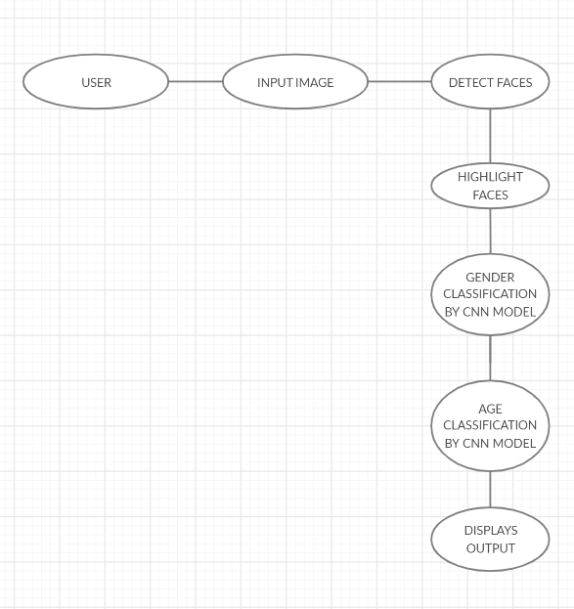
SYSTEM ARCHITECTURE

Slide 11
SYSTEM MODULES
1. Function to load caffe model
We have defined a function load_caffe_models() to load caffemodel and prototxt of both age and gender detector, these are basically pre-trained CNN models which will do the detection.
2. blobFromImage()
OpenCV provides this function to facilitate image preprocessing for deep learning classification. It performs :Mean subtraction Scaling And optionally channel swapping.
3. Facial Detection
The objective of this module is to identify or detect objects of interest(faces) in real time and to keep track of the objects.
4.Age & Gender Detection
These modules consists of algorithms that are based on features. They extract information from images and maps out series of interest points such as edges of eyes, lips and nostrils and finally classify the age and gender of a person.

Slide 12
DATASET
The dataset used for training and testing for this project is the Adience face dataset, which comes from the Face Image Project from the Open University of Israel (OUI).
This dataset contains a total of 26,580 photos of 2,284 unique subjects that are collected from Flickr. Each image is annotated with the person’s gender and age-range (out of 8 possible ranges).
The images are subject to various levels of occlusion, lighting, and blur, which reflects real-world circumstances.
I used those images which were mostly front facing, which limited the total number of images to around 20,000.

Slide 13
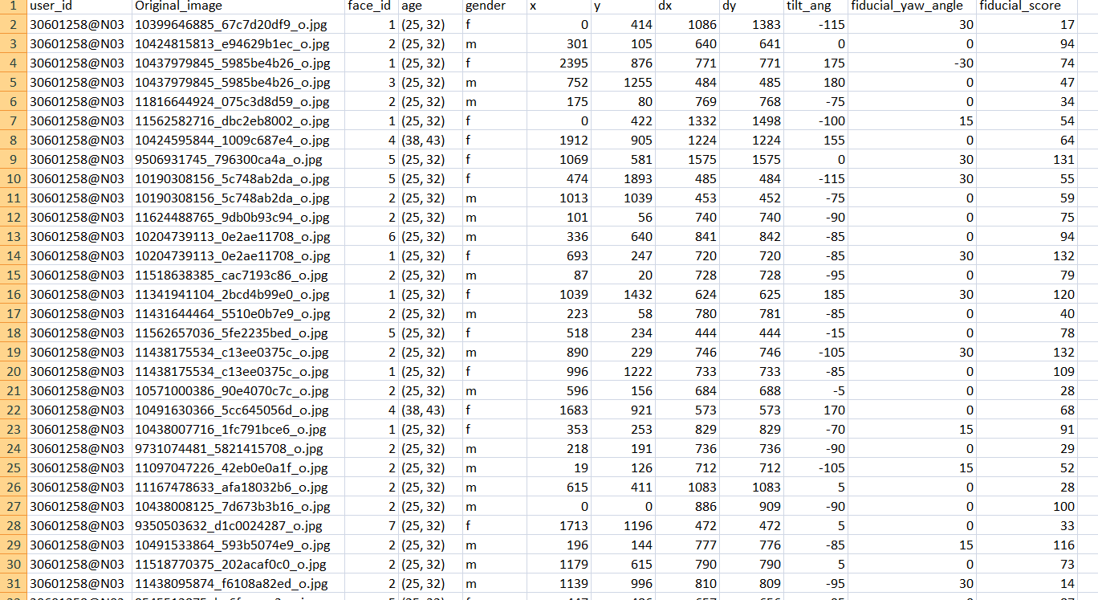

Slide 14
METHODOLOGY
I have used Convolutional neural networks for gender and age classification.
Convolutional neural networks (CNN) is a special architecture of artificial neural networks which were build to function as a copy of our brain.
The CNN model here consists of three channels and input channel image is of 227*227 pixel respectively.
It consists of 3 convolution layers and 2 fully connected layers.

Slide 15
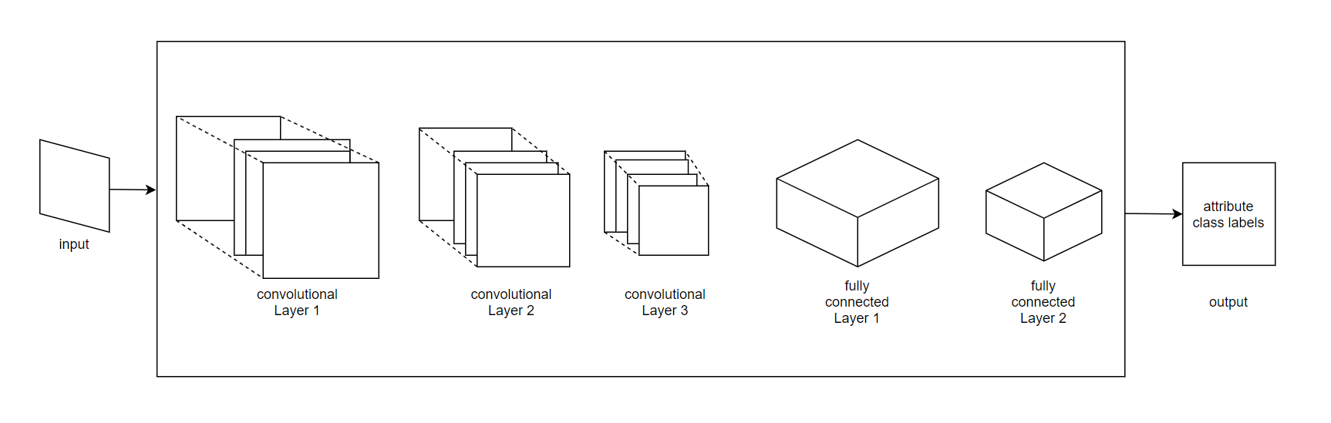
CNN ARCHITECTURE

Slide 16
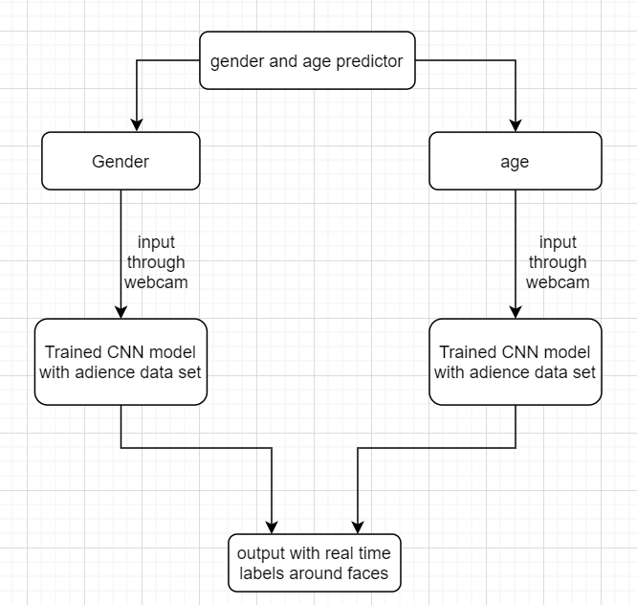
DATA FLOW DIAGRAM

Slide 17
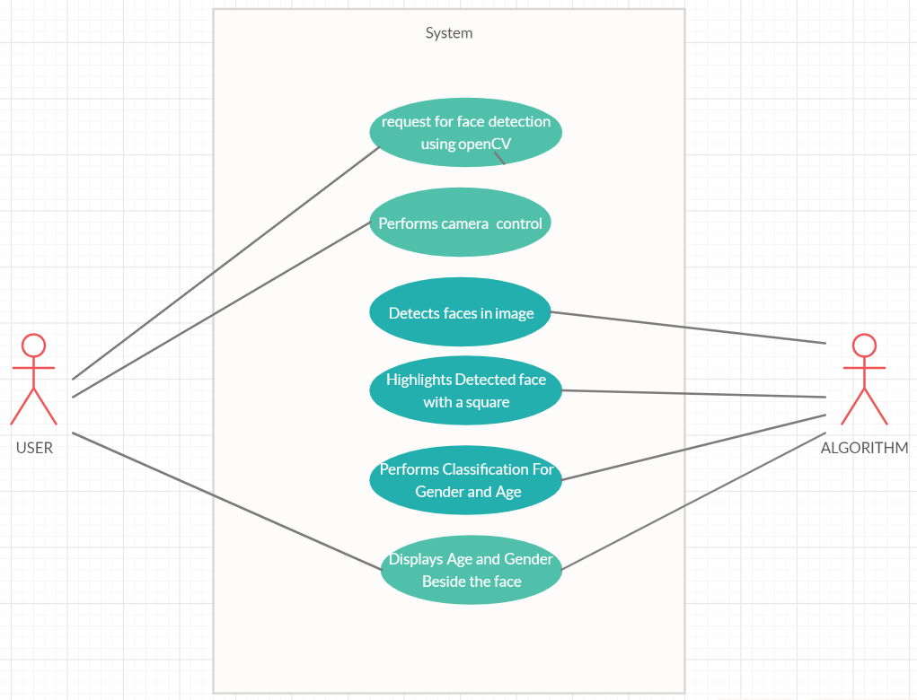
USE CASE DIAGRAM

Slide 18
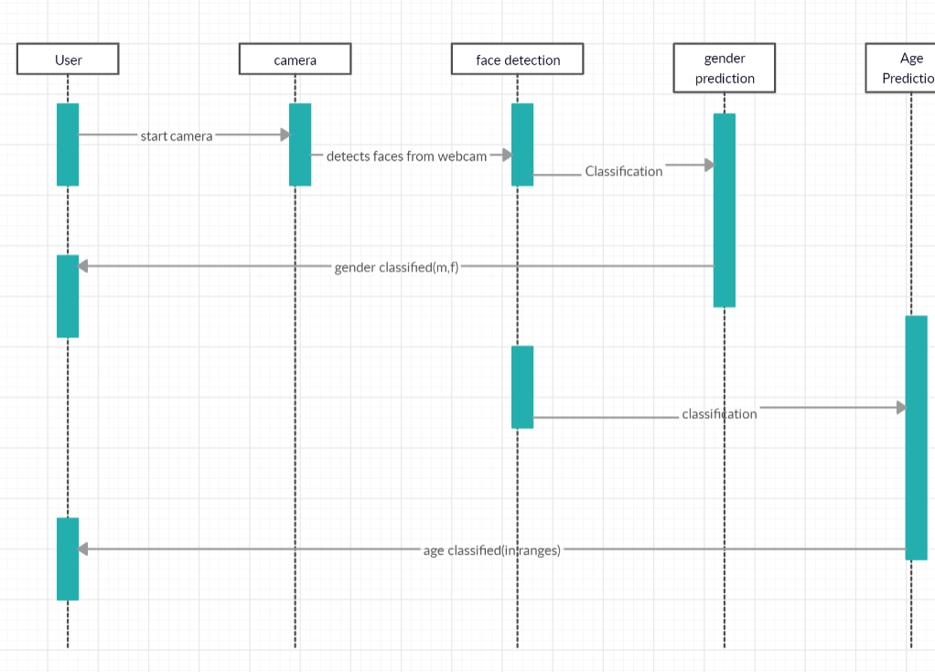
SEQUENCE DIAGRAM

Slide 19
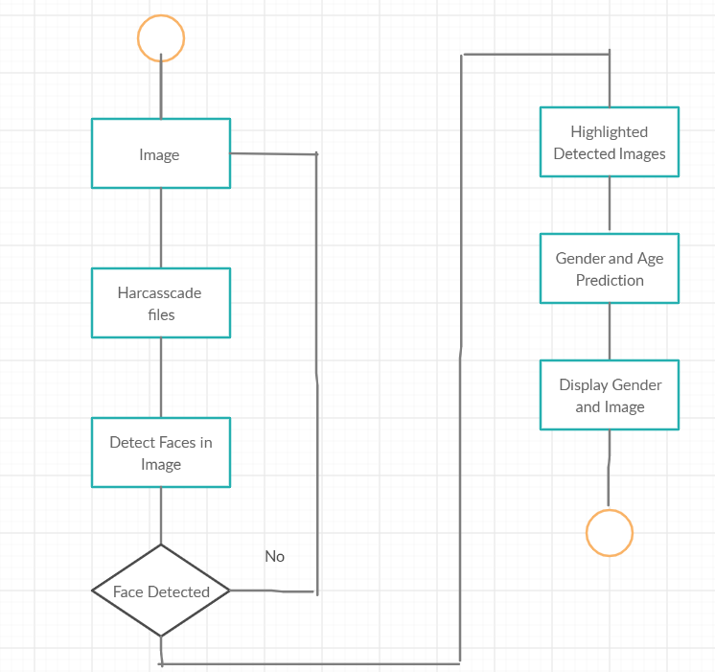
COLLABORATION DIAGRAM

Slide 20
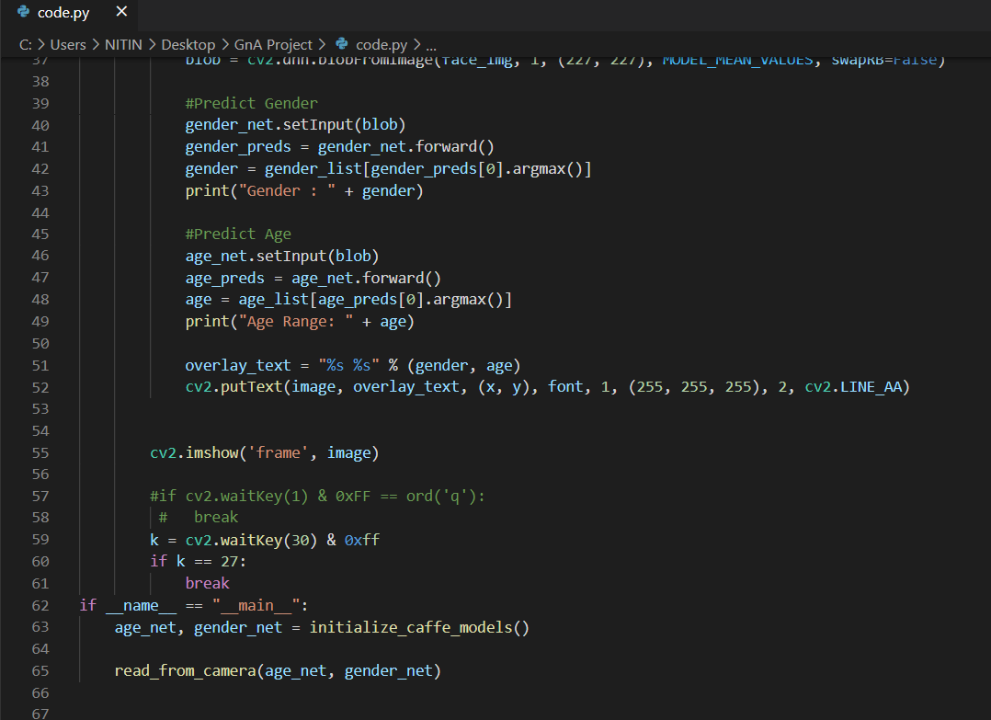

EXECUTION
INPUT
Input for this model is in Video format which is recorded through webcam. Recording frame is opened as soon as I run the code as shown below.

Slide 21
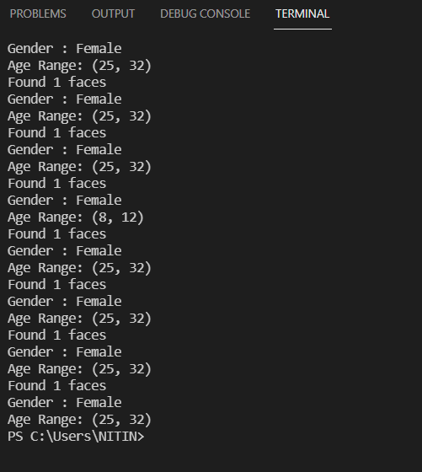
OUTPUT
The model detects all the faces that appear in front of the camera, detects the age and gender of each face and lists these details as output.

Slide 22
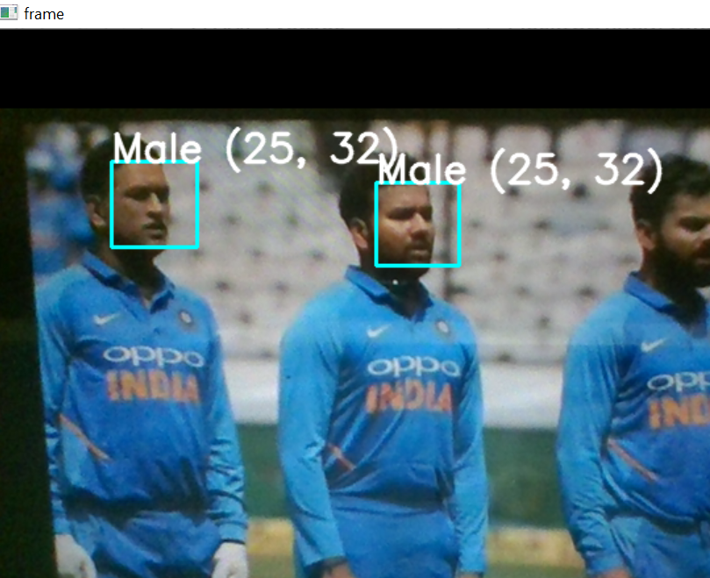
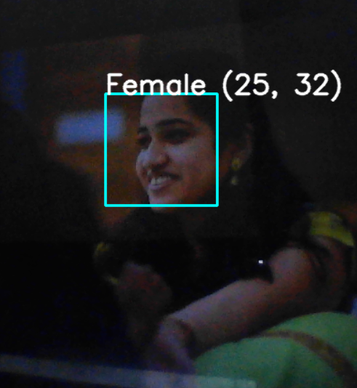
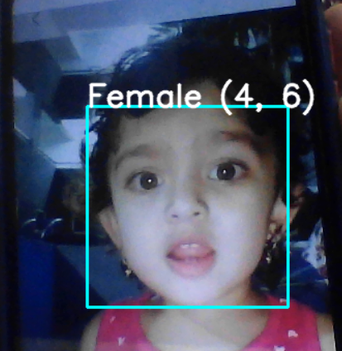
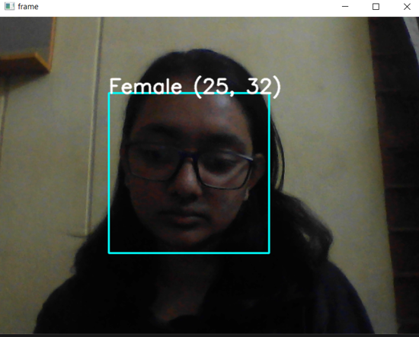
The above image display the gender and age range. As you can see the face in the image is highlighted and gender and age is predicted.

Slide 23
SYSTEM SCOPE
The scope of the project is really bright as this can be used in several different areas for more efficient results.
Few examples where Age and Gender prediction can help are access control, human-computer interaction, law enforcement, marketing intelligence and visual surveillance.
It can also help mankind and can significantly reduce the hardness and time consumed for a tedious task.

Slide 24
CONCLUSION
Hence, here a fast and efficient gender classification and age estimation system based on facial features is proposed to classify the gender and age prediction.
The proposed technique has given good results when applied in real-world scenarios.
As future work, I would like to study the improvement on classification accuracy theoretically to other real-world pattern classification problems.

Slide 25
REFERENCES
A. Kumar and F. Shaik,” Importance of Image Processing”, 2016.
Chenjing Yan, Congyan Lang, Tao Wang, Xuetao Du, and Chen Zhang, "Age Estimation Based on Convolutional Neural Network”, 2014 Springer International Publishing Switzerland .
https://www.learnopencv.com/age-gender-classification-using-opencv-deep-learning-c-python/
https://www.researchgate.net/publication/318084198_Age_and_Gender_Recognition_in_the_Wild_with_Deep_Attention
https://towardsdatascience.com/predict-age-and-gender-using-convolutional-neural-network-and-opencv-fd90390e3ce6

Slide 26
THANK YOU ☺

